Slide 1
BME/CS 479 Lab 1
Carson Goodwin, Kofi McNair, Saif Kazmi, Group 3, Lab 1
19 September 2023

Slide 2
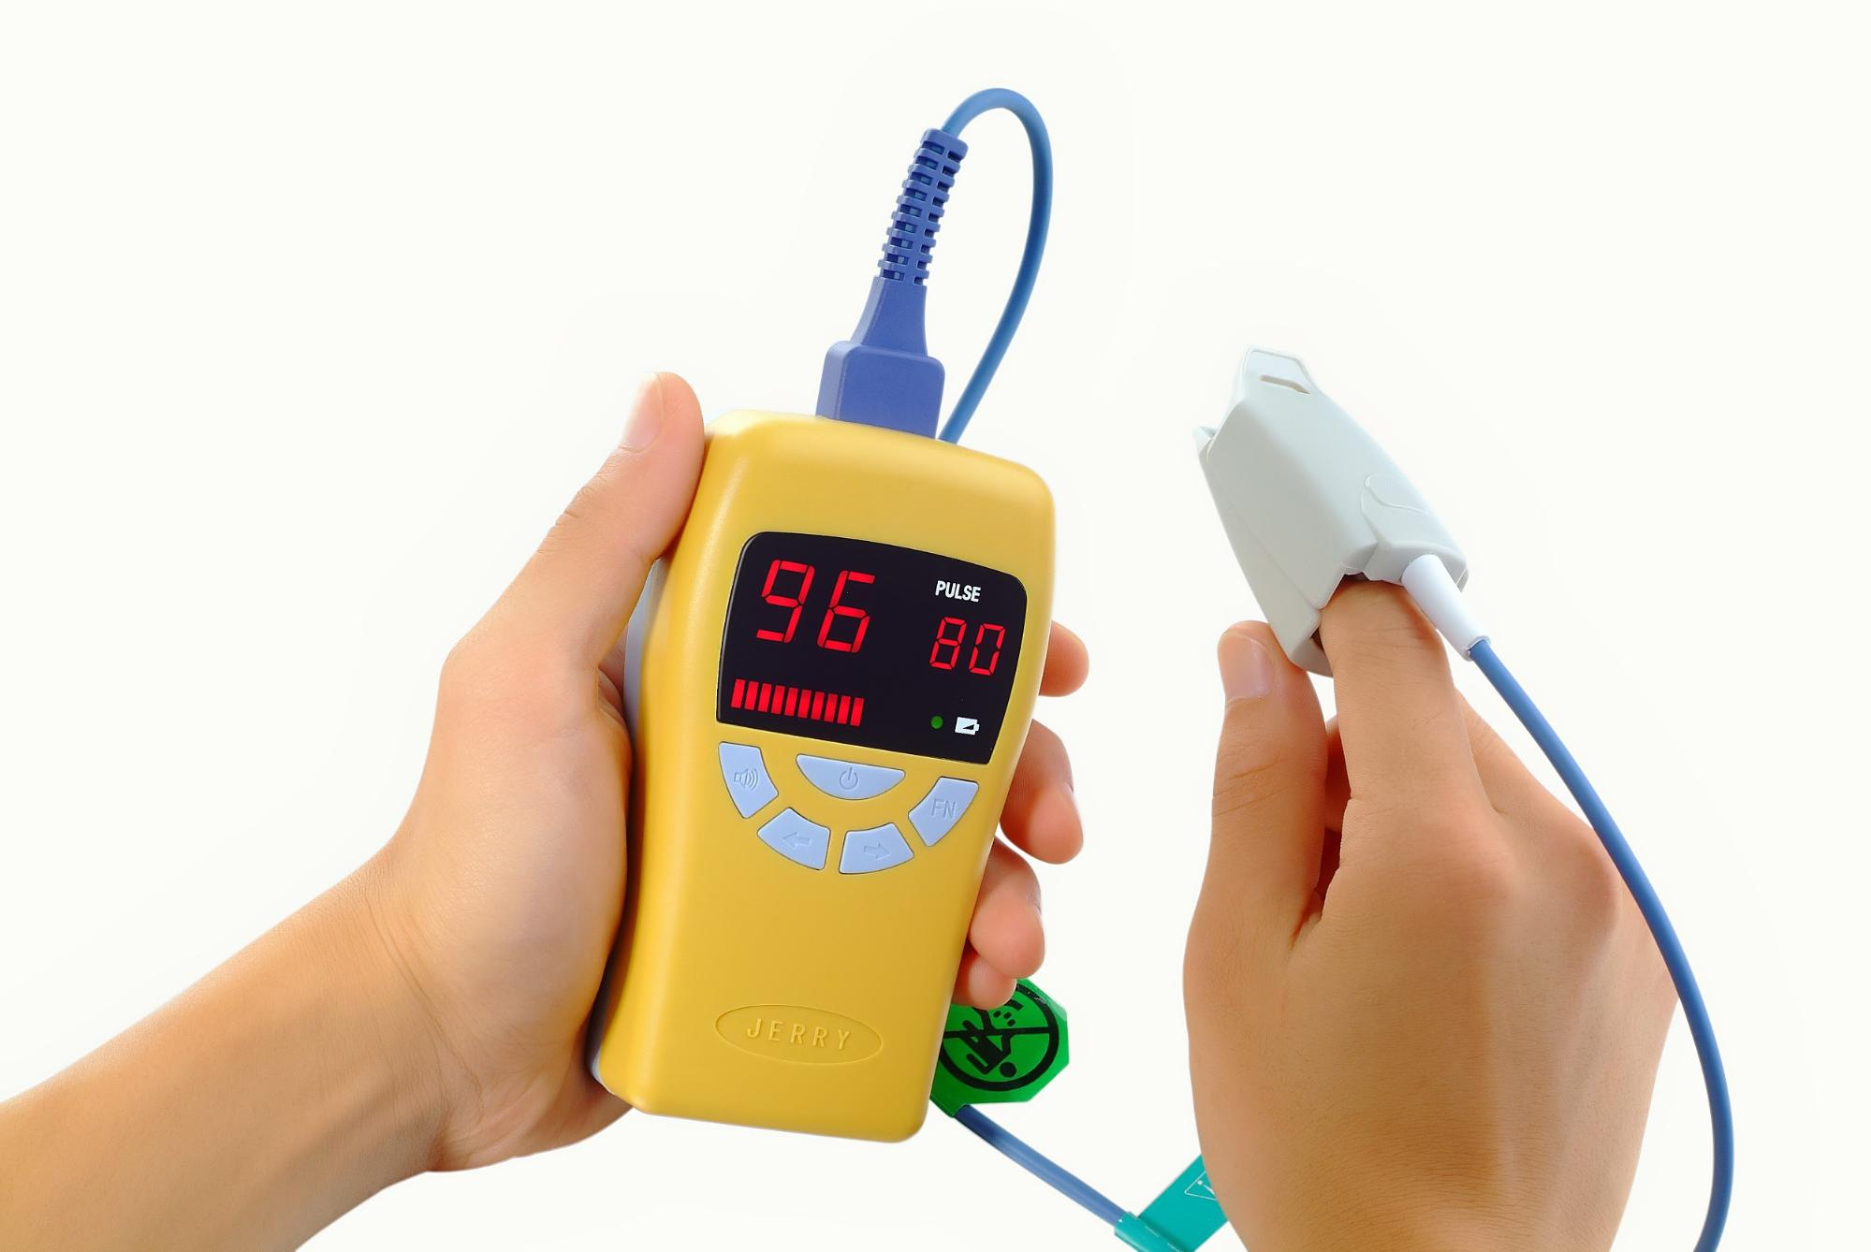
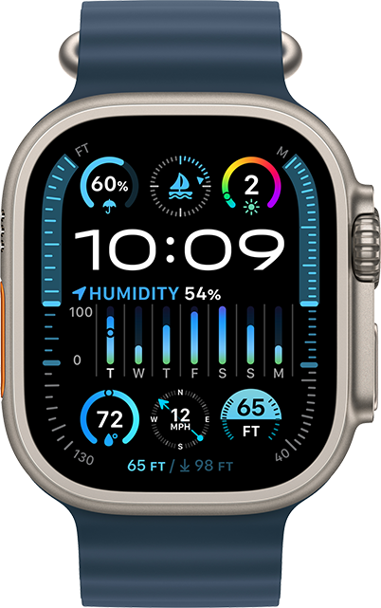
Introduction
Revolutionizing non-invasive monitoring with compactness without compromising precision."
The sensors: advanced optical technology (Photoplethesmogram signals- where a light-based signal is used to determine O2 saturation and heart rate
I2C – the bridge between the pulse oximeter sensor and the fireBeetle Boards-328P
Design: to be worn on the wrist and the index finger: comfort, precision, user friendliness
Personalized Wearable Pulse Oximeter: A Leap into the Future of Healthcare.
Notes:
A tomorrow were pt can remotely access and communicate with their healthcare providers without compromising precision of their health information like HR and O2 which could be vital health indicators that their physicians can use in their health management, is what we hope for
Photoplethesmography works by
As the arteries in the fingure is filled with oxygynated blood light waves are refracted and signals are recoreded based on the change in the pulsatile arteries and recorded as Hearth rate and oxygen saturation

Slide 3
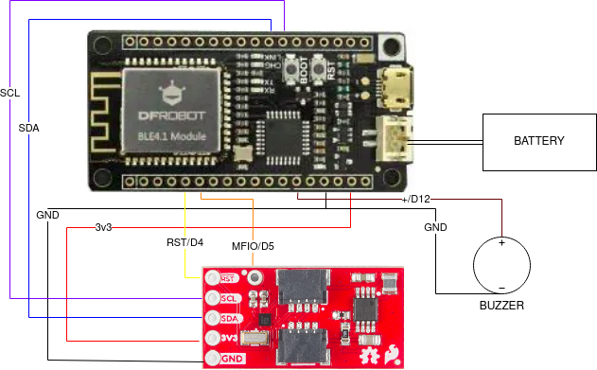
Methods – Hardware
Circuit Diagram
HR monitor, buzzer, and battery connected to peripheral board
HR monitor wired according to manufacturer specifications using 3.3V
Buzzer connected to digital pin and ground

Slide 4
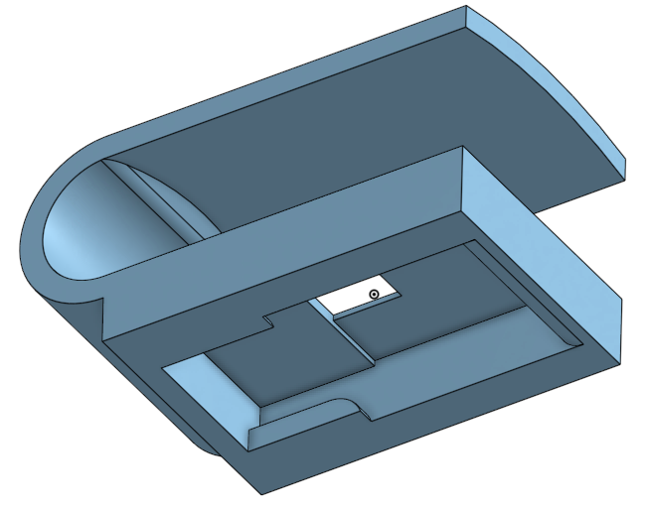
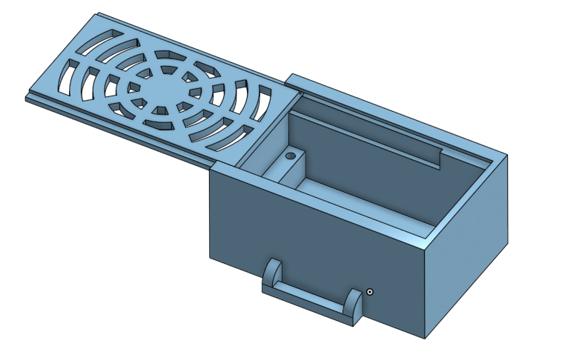
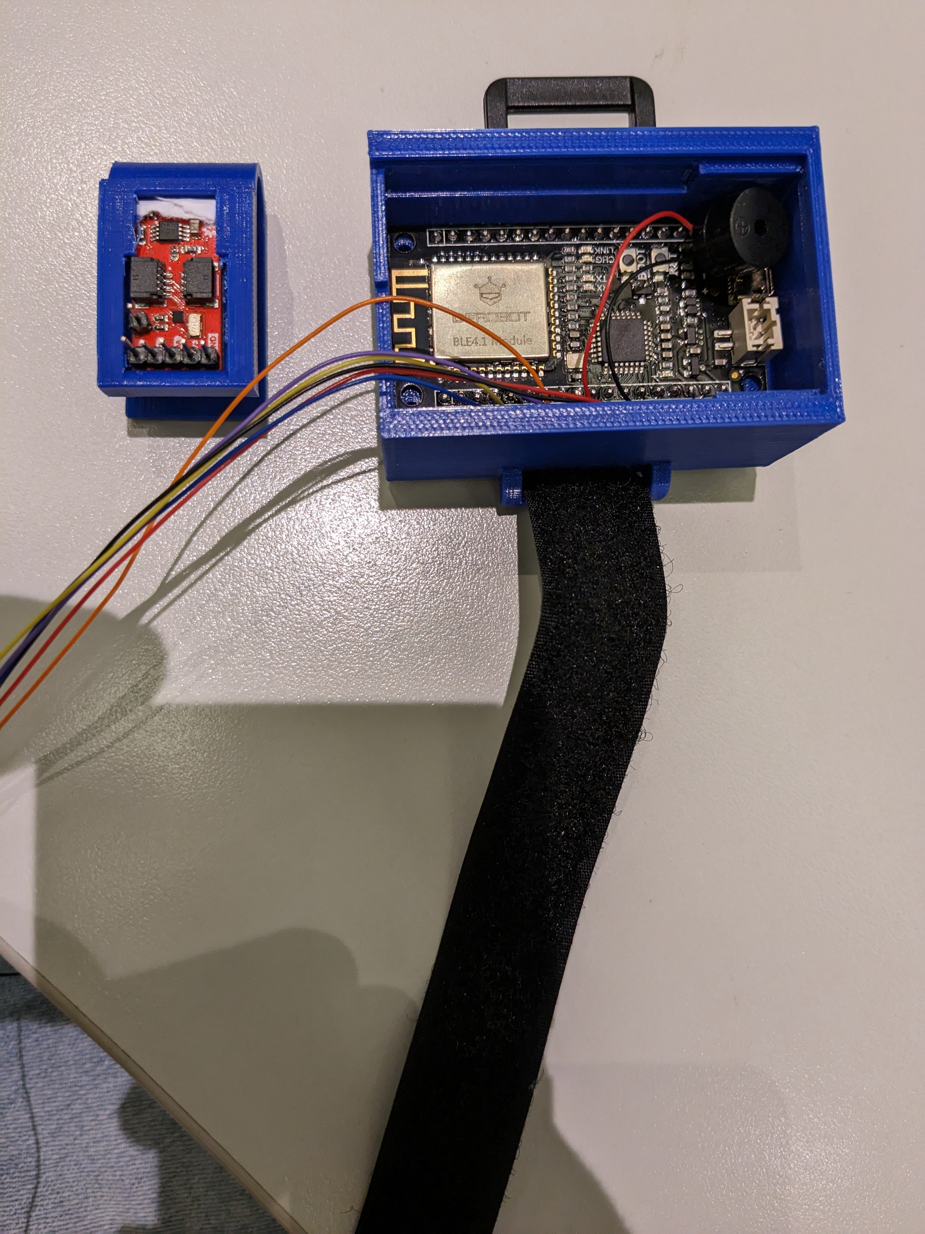
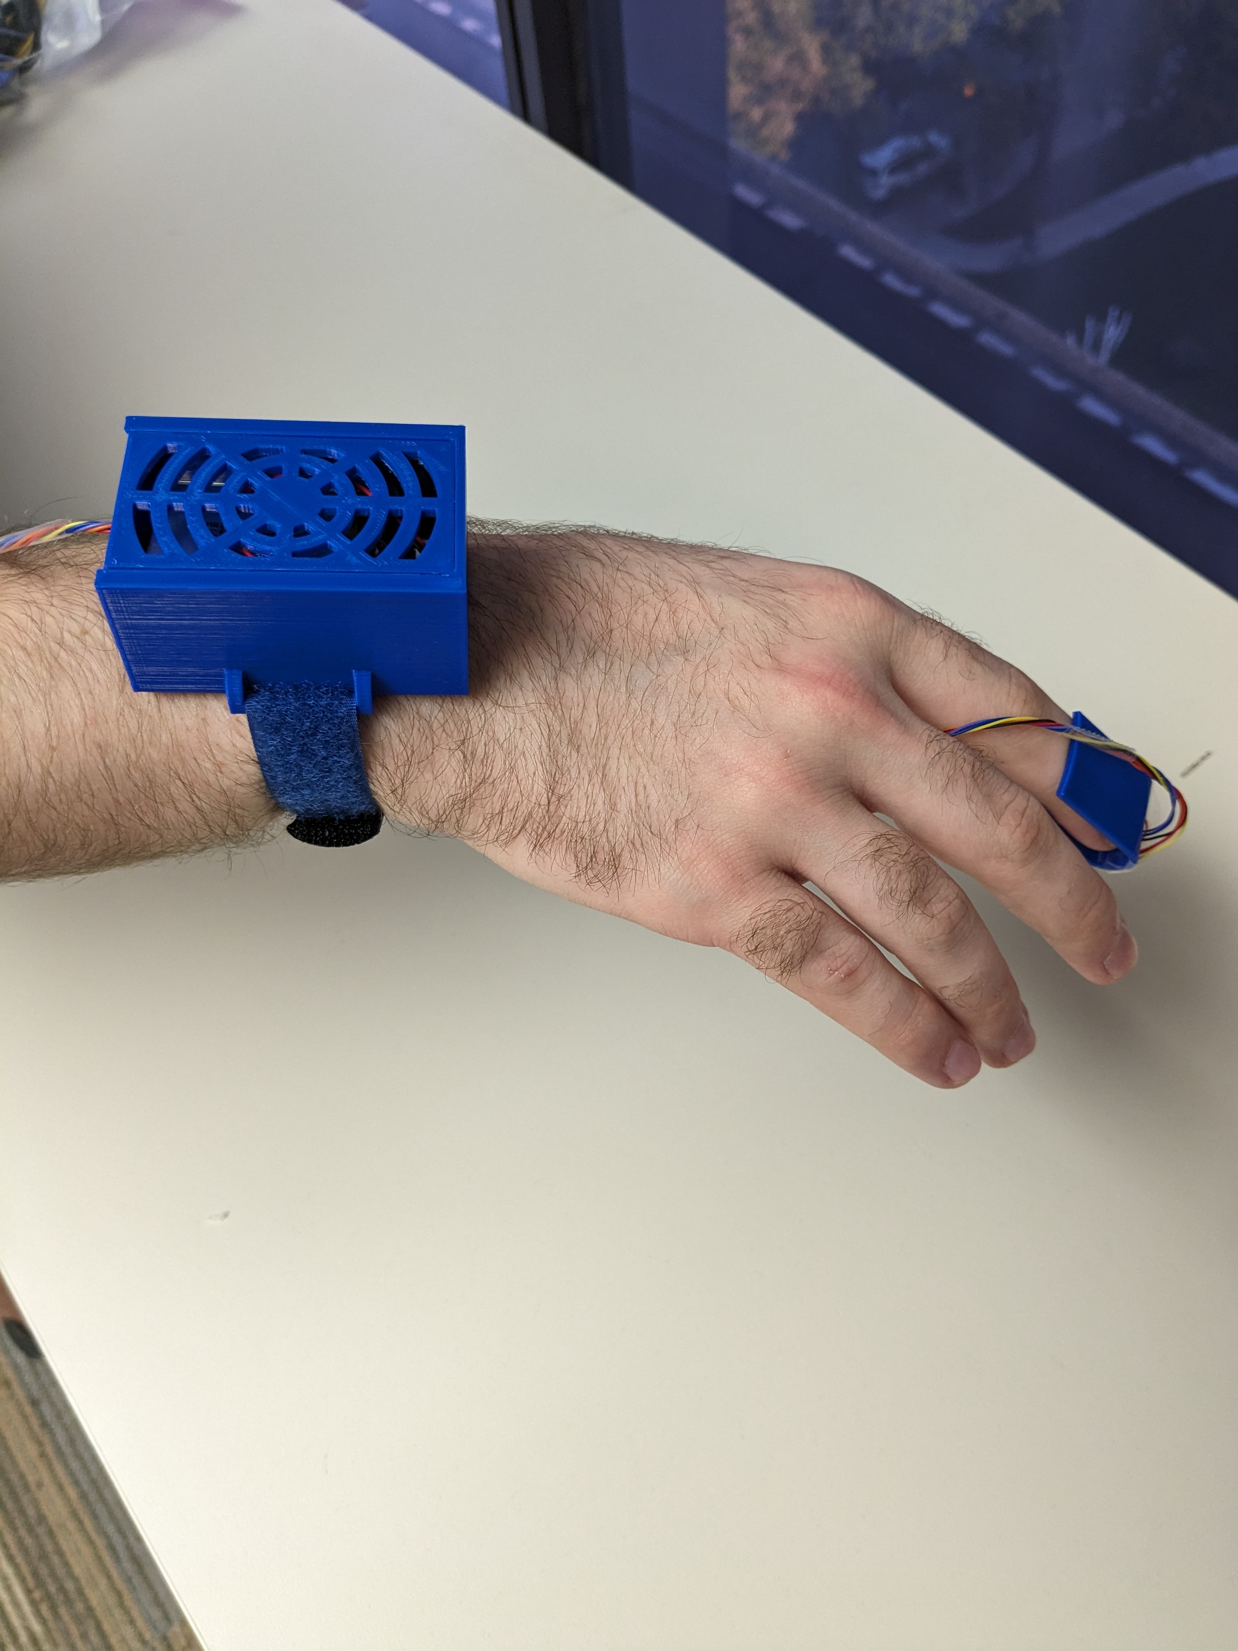
Methods – Hardware (cont.)
HR Monitor Clip
Securely holds HR monitor while only exposing sensor
Clip securely slides on index finger
Enclosure
Designed to hold peripheral board, buzzer, and battery
Attached to wrist using Velcro strap

Slide 5
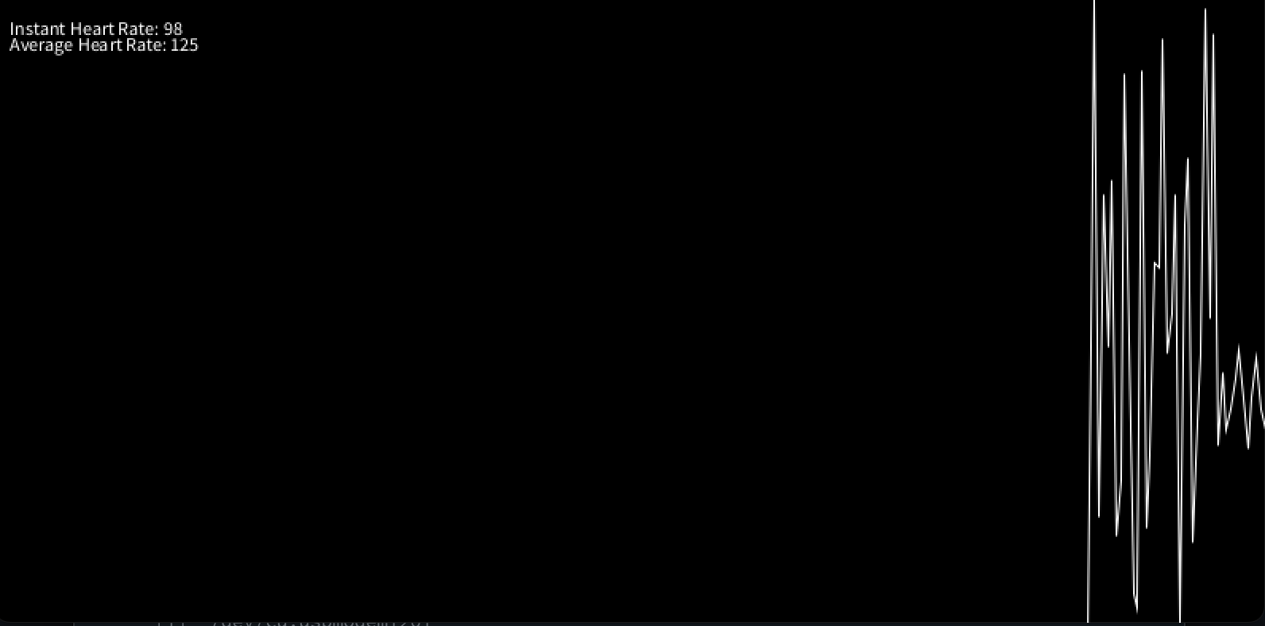
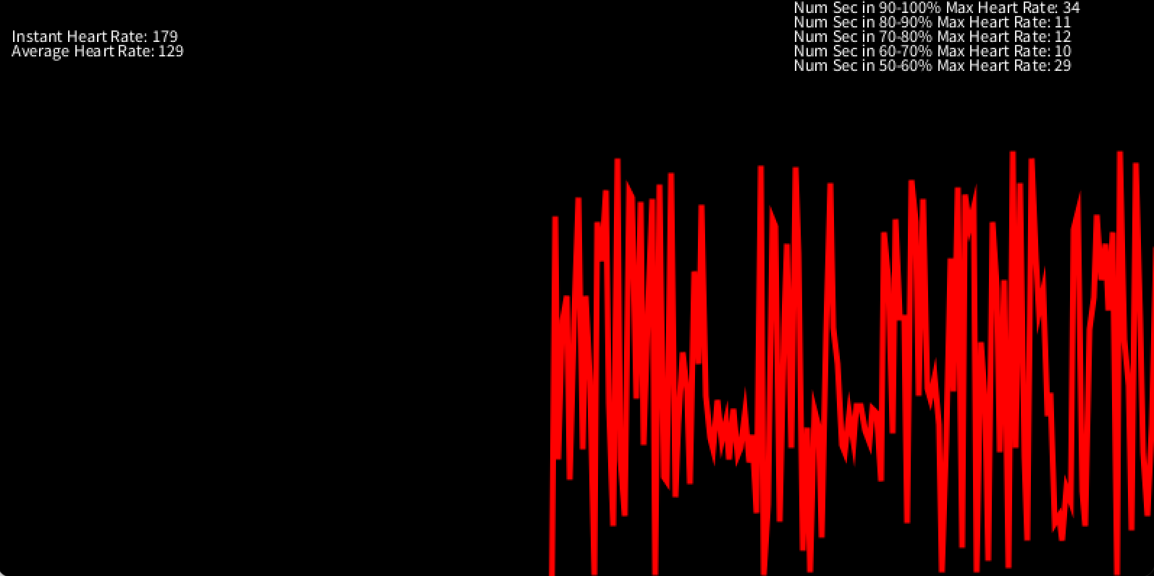
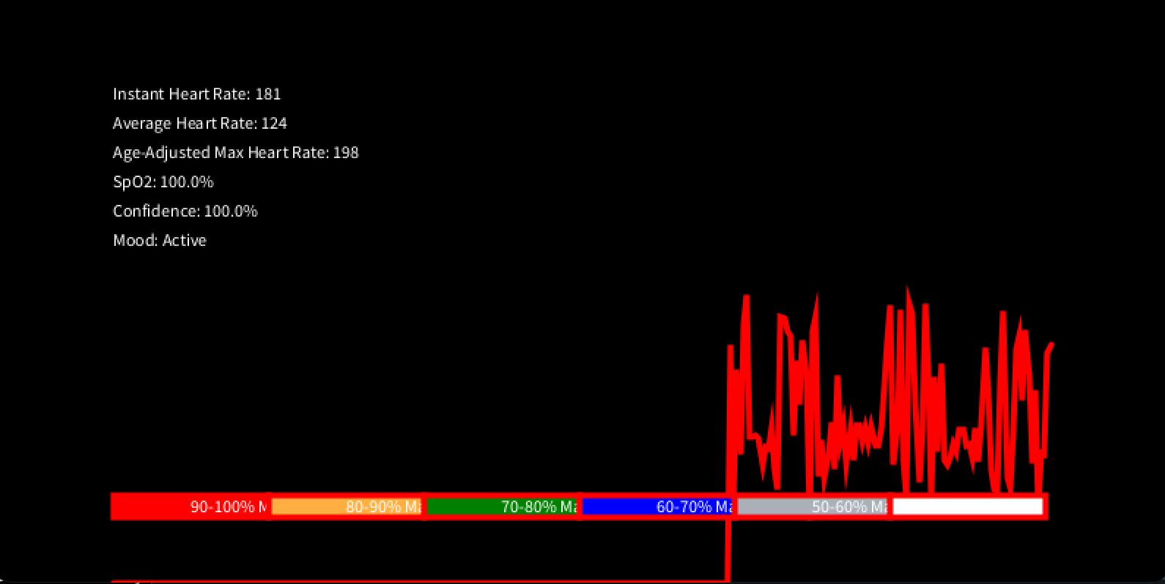
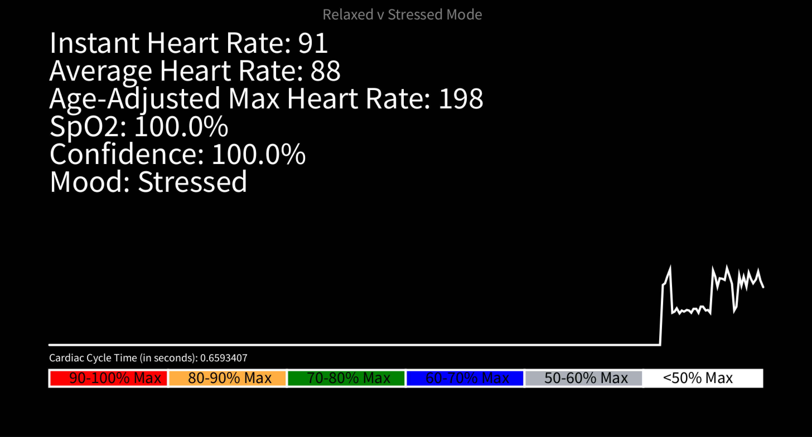
Methods – User Interface
Iteration 1
Iteration 2
Iteration 3
Iteration 4

Slide 6
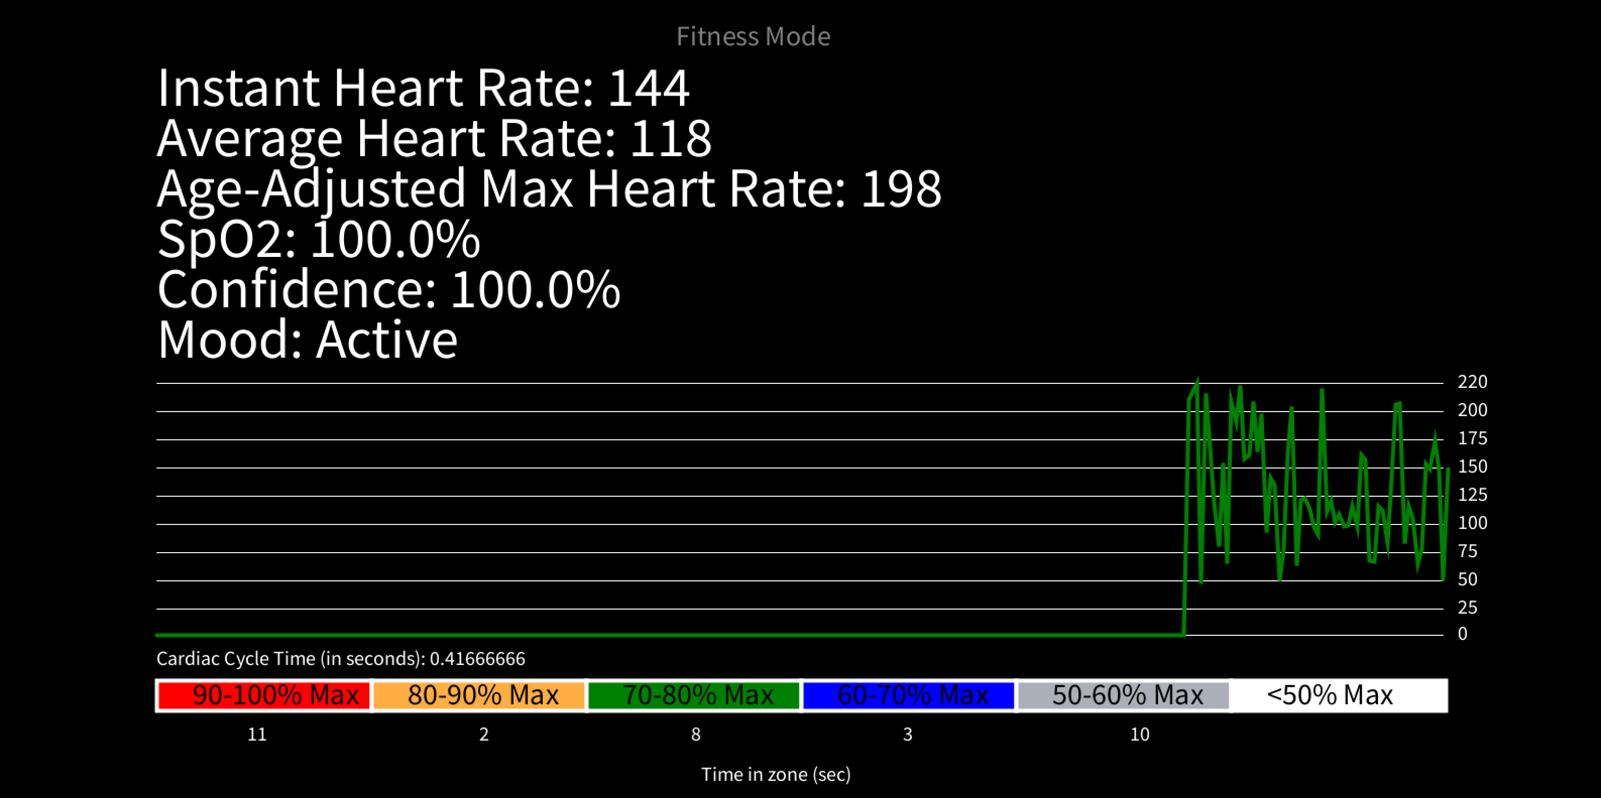
Methods – User Interface (cont.)
How did you process the data?:
What we ended up doing to process the data was using a line graph based system where the x-axis spans the last 300 seconds and the y-axis is the instant heart rate at that exact moment.
Taking all the heart rate values over that x-axis, adding them up, and dividing them by the number of measurements helps us provide an average heart rate over the period of app usage
What filters/algorithms/noise reduction techniques did you use/develop?:
For any kind of spike sensitive calculations,
(e.g. Relaxed vs Stressed mode), we use an averaging system.
This allows us to measure the average heart rate over a period of time, compare that to the next measurement and conclude whether the user is gaining stress or reducing stress by seeing if the averages are significantly (+10%) different.
Final Iteration

Slide 7


Conclusion
Limitations:
How do we know how accurate this sensor really is?
We can only make the device so small because of the off the shelf components
Limited by our chosen tools and current skillsets
Challenges:
How do we determine that a User is stressed or not?
HR & O2 only provide some limited clues
Further research and multi-modal sensing may offer a solution."
How do we have multi directional serial between Processing and Arduino
How do we create a competent UI that encompasses all of the info we want to display to the user?

Slide 8
Future Work
Integration of an accelerometer for activity context
Inclusion of more sensors for a comprehensive health report

